Slide 1


Slide 2


The TEAM
Azmi
Scrum Master/ Solution Designer
Syafiq
Lead Developer
Siti Hajar
Developer
Shahrul Amir
Developer
Fadzli
Developer
Product Owner
Solution Designer
Other Unit in UTMDigital
DEVELOPMENT TEAM
Frontend/Backend Developer
Notes:
Scrum Master - Making sure a Scrum team lives by the values and practices of Scrum
Responsibilities of this role:
Clearing obstacles
Establishing an environment where the team can be effective
Addressing team dynamics
Ensuring a good relationship between the team and product owner as well as others outside the team
Protecting the team from outside interruptions and distractions.
Solution Designer - Responsible for designing the essential core 'building block's that make up a technical solution.
Responsibilities of this role:
Responsible for the overall integrity of solution so must have knowledge of existing system set, the company’s overall systems strategy and any applicable IT standards.

Slide 3
Methodology – Agile Scrum

Slide 4
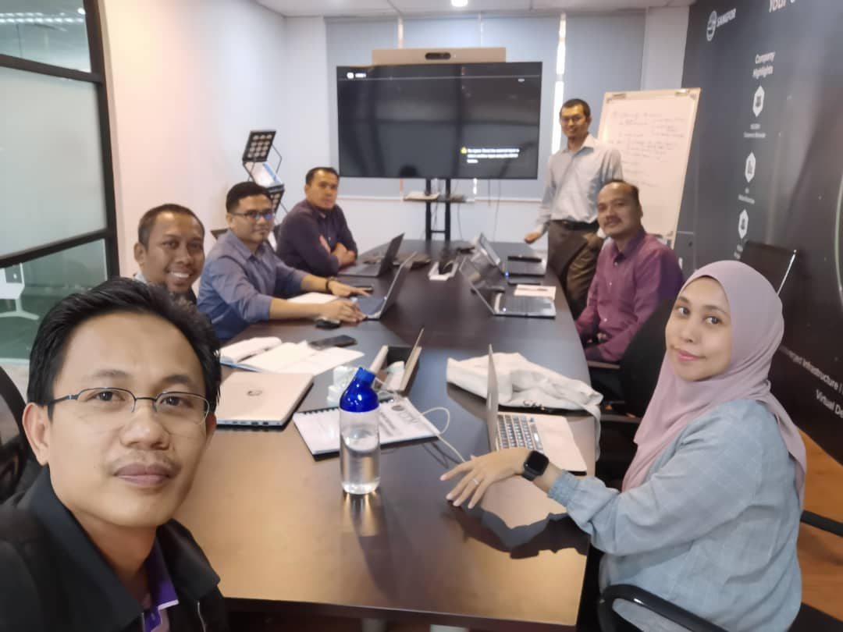
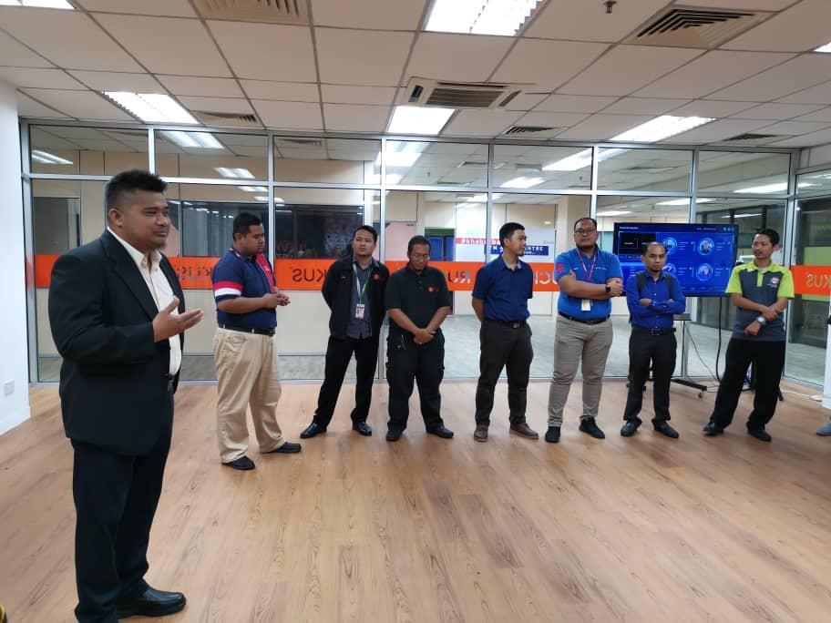
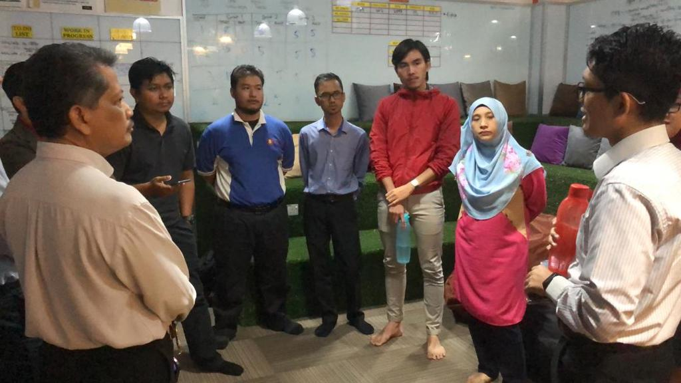
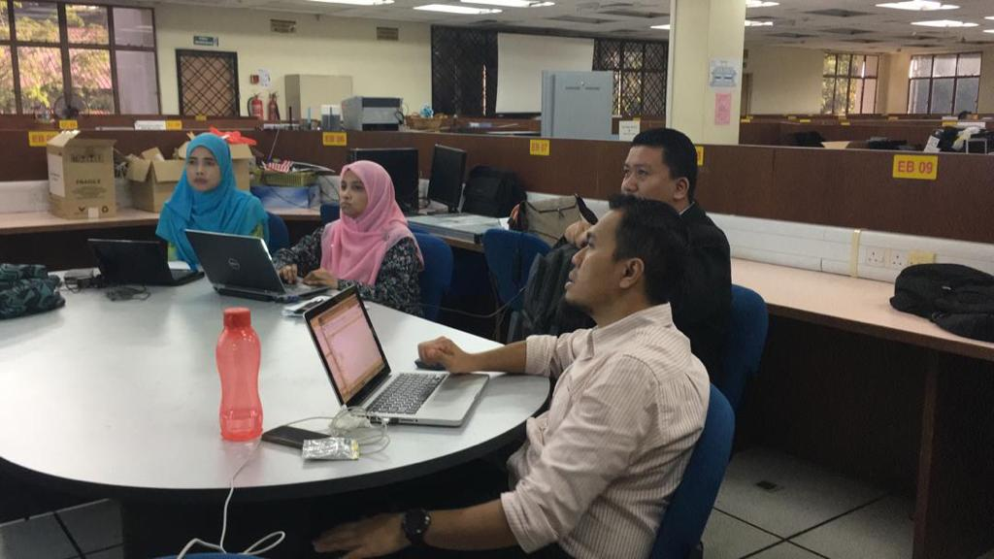
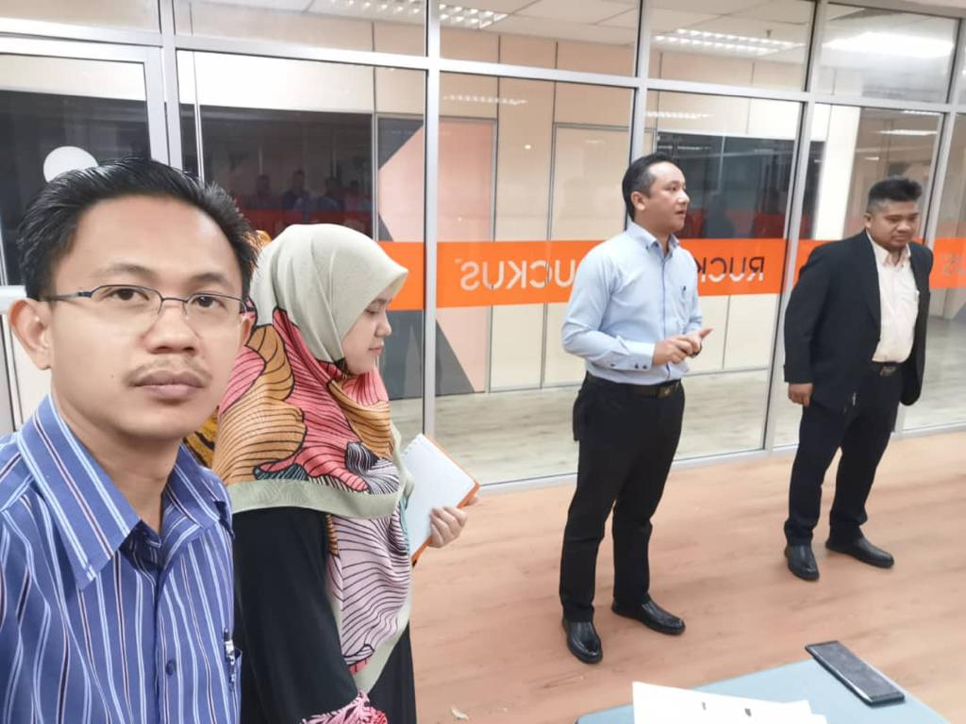
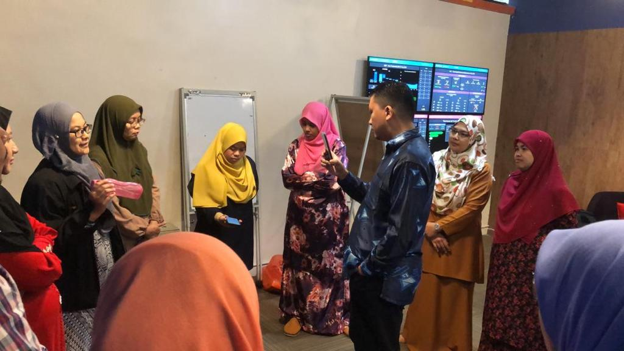
Daily Scrum – Stand Up Meeting

Slide 5
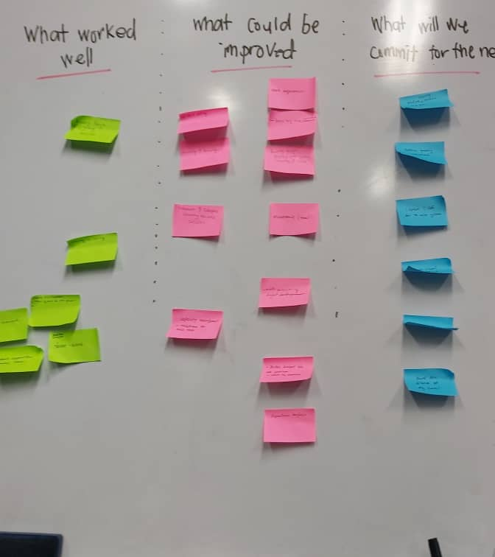
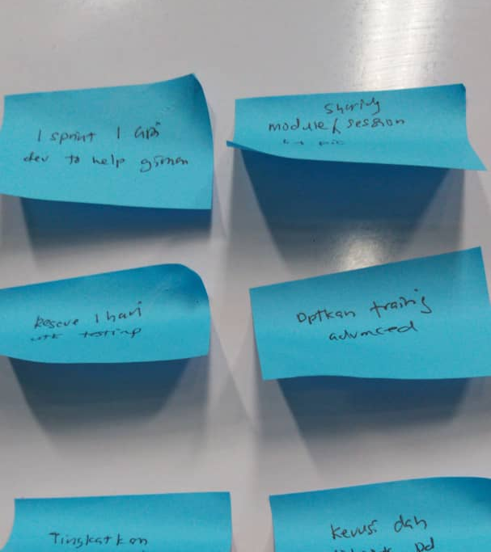
Agile Board

Slide 6
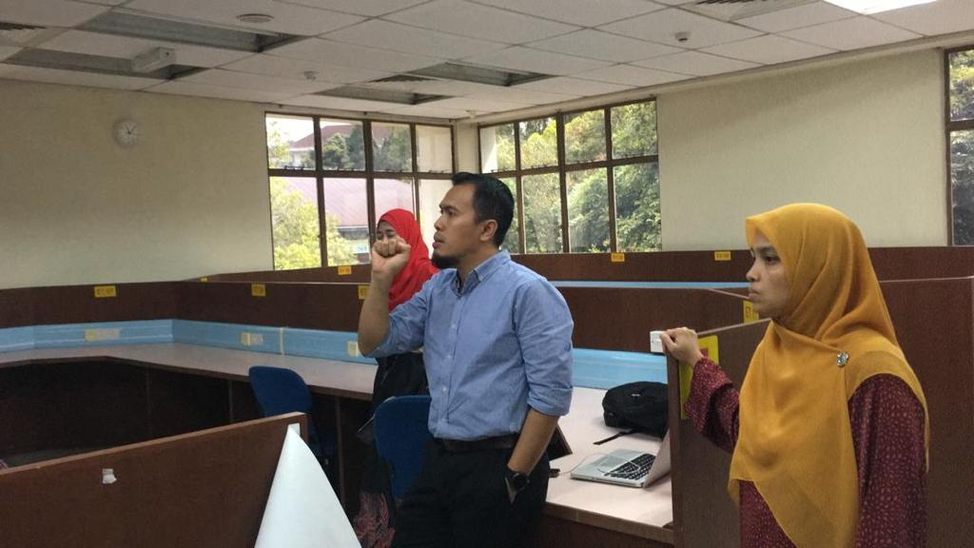
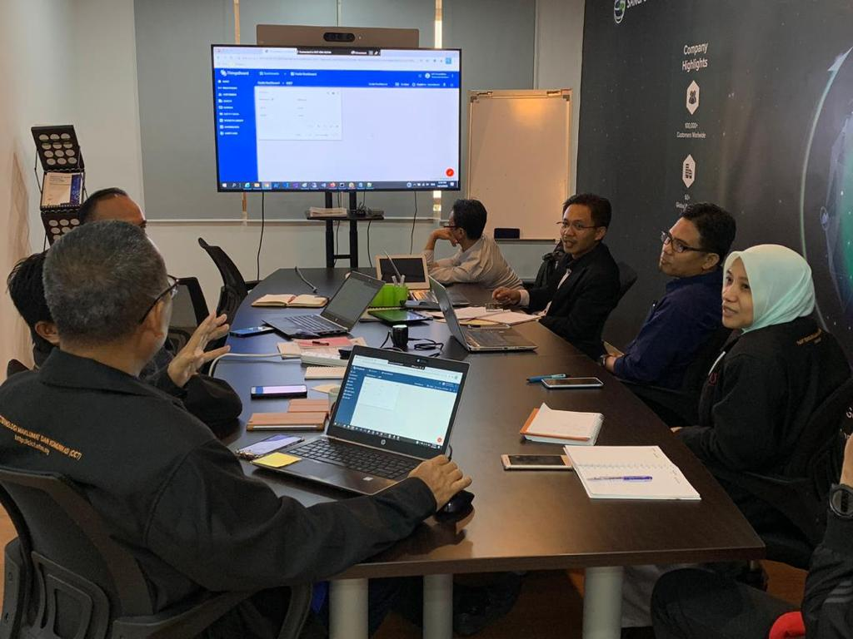
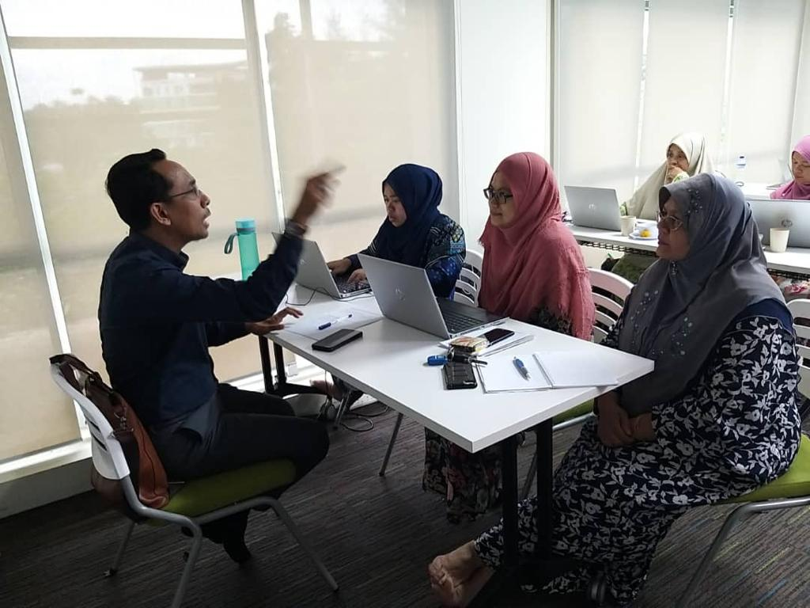
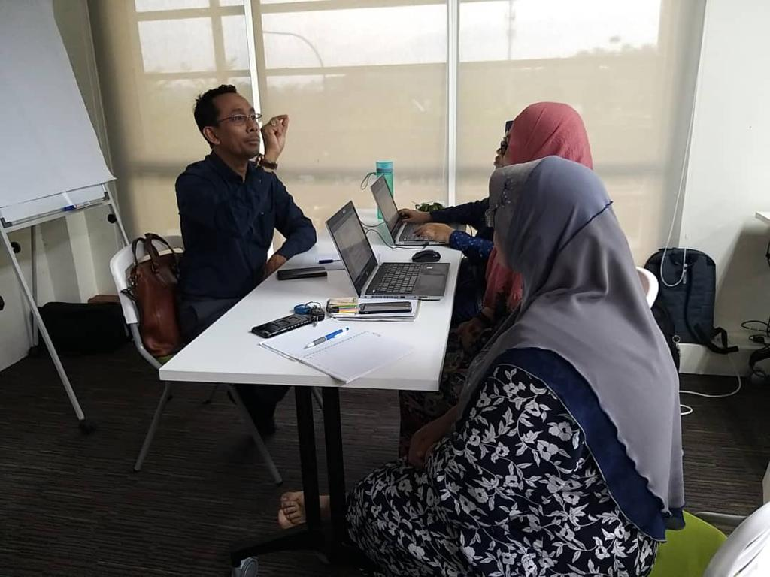
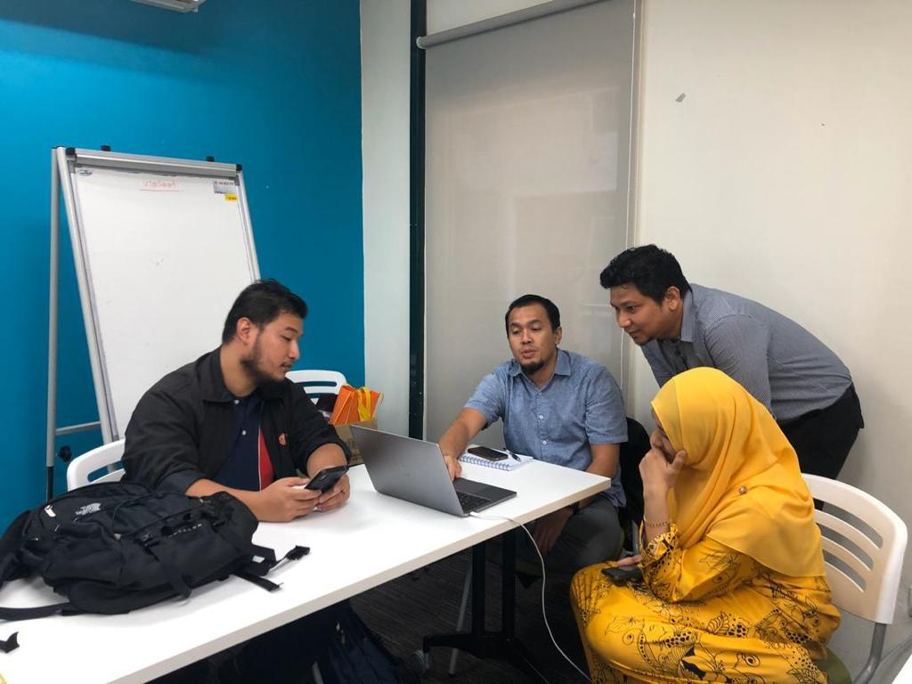
User Discussion

Slide 7















Technology
Agile Tool
Integration Tool
DevOps Tool
Development Tool
Collaboration Tool
Notes:
Agile Tools Definitions
Taiga - an open-source project management software that supports teams that work Agile across both Scrum and Kanban frameworks.
ClickUp - a cloud-based collaboration and project management tool suitable for businesses of all sizes and industries.
DevOps Tool Definition
Renogen - a development tool to separate feature notes from product versions.
Integration Tools Definitions
Sourcetree - a free Git desktop client for developers on Windows.
Visual Studio - an integrated development environment that is used to develop computer programs for Windows.
Postman - a popular API client that makes it easy for developers to create, share, test and document APIs.
GitLab - an open source end-to-end software development platform with built-in version control, issue tracking, code review, CI/CD, and more.
Runner - an application that works with GitLab CI/CD to run jobs in a pipeline.
Swagger - an Interface Description Language for describing RESTful APIs expressed using JSON.
Development Tools Definitions
Ionic - a powerful HTML5 SDK that helps you build native-feeling mobile apps using web technologies like HTML, CSS, and Javascript.
Microsoft.net - a software framework developed by Microsoft that runs primarily on Microsoft Windows.
PHP - a popular general-purpose scripting language that is especially suited to web development.
One signal - the fastest and most reliable service to send push notifications, in-app messages, and emails to your users on mobile and web, including content management platforms like Wordpress and Shopify.
Oracle Database - a multi-model relational database management system, mainly designed for enterprise grid computing and data warehousing.
MySQL - a fully managed database service to deploy cloud-native applications.

Slide 8
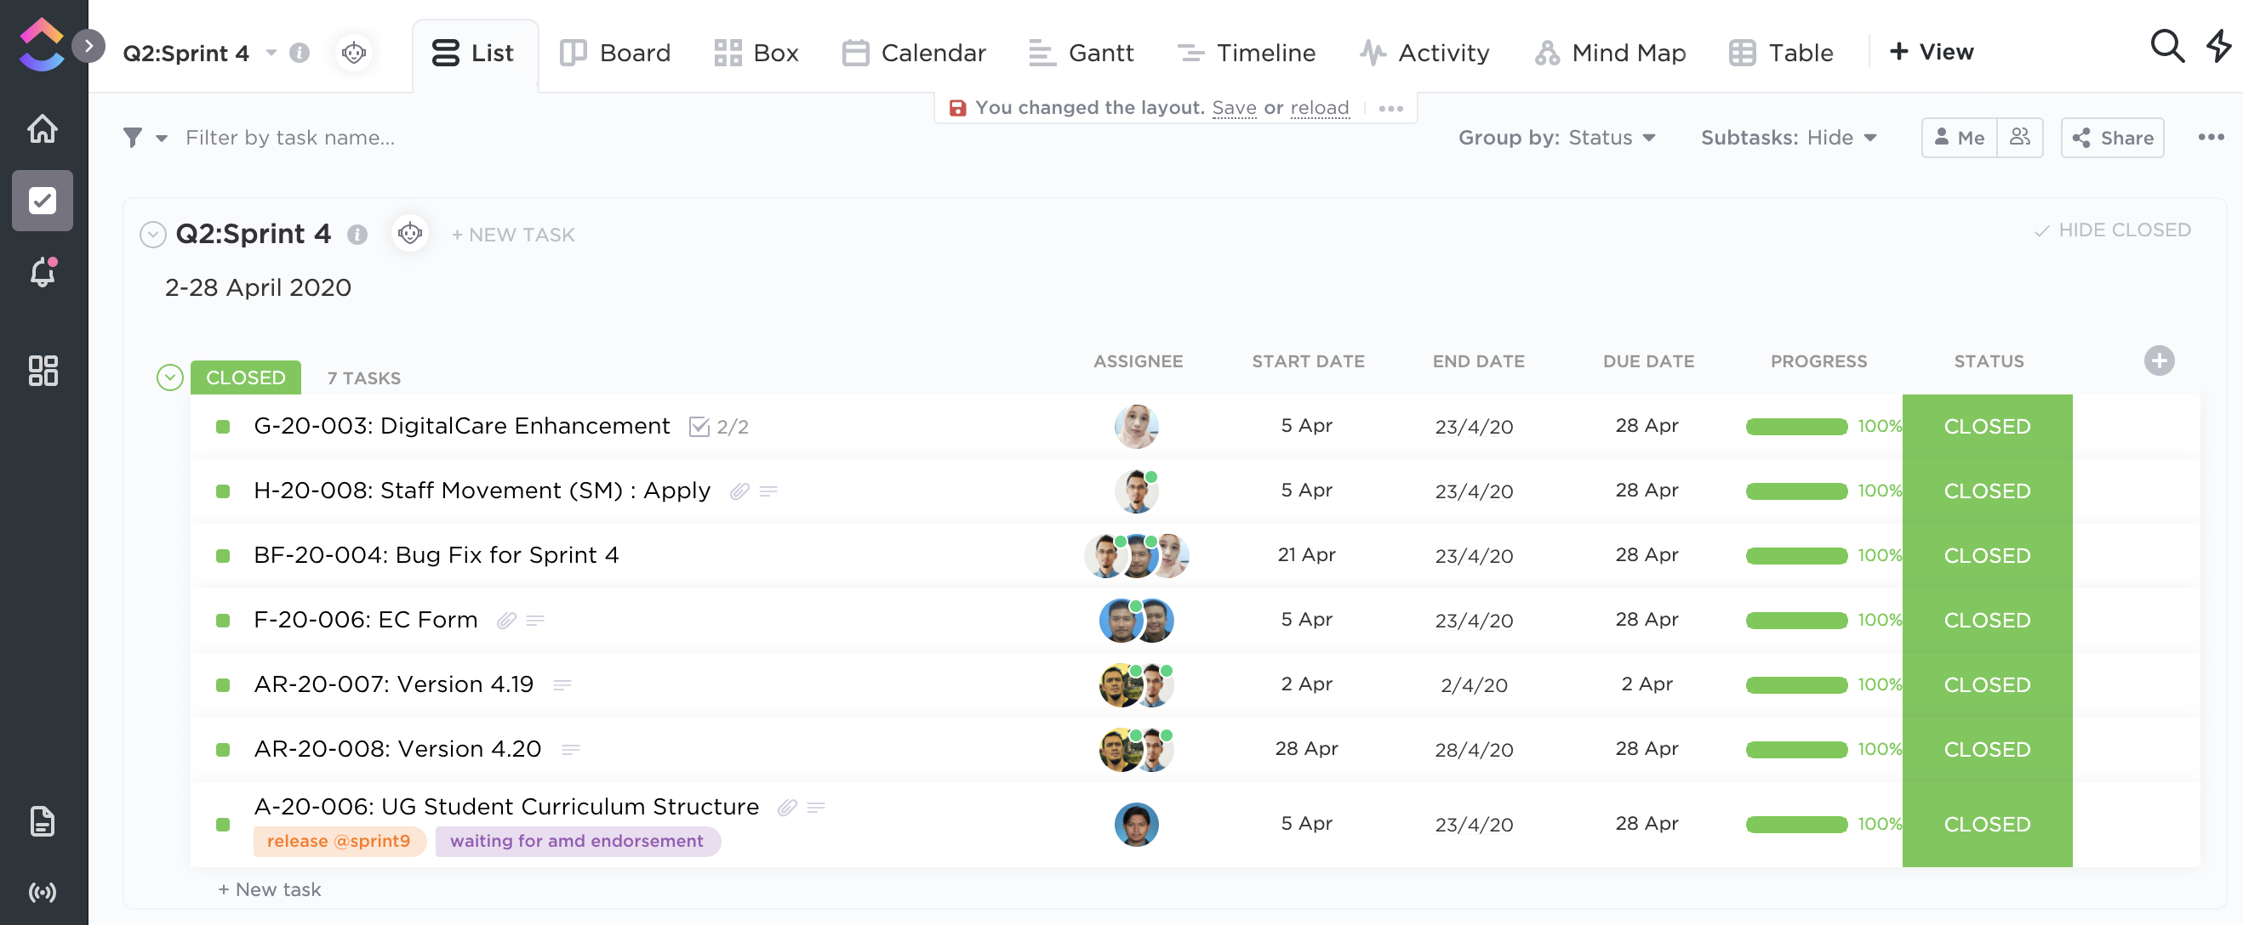
Agile Tool: Clickup

Slide 9
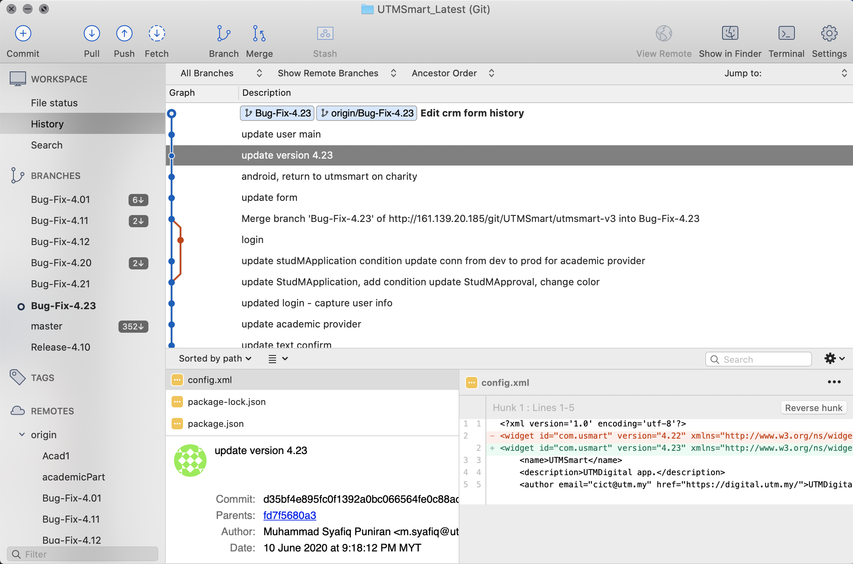
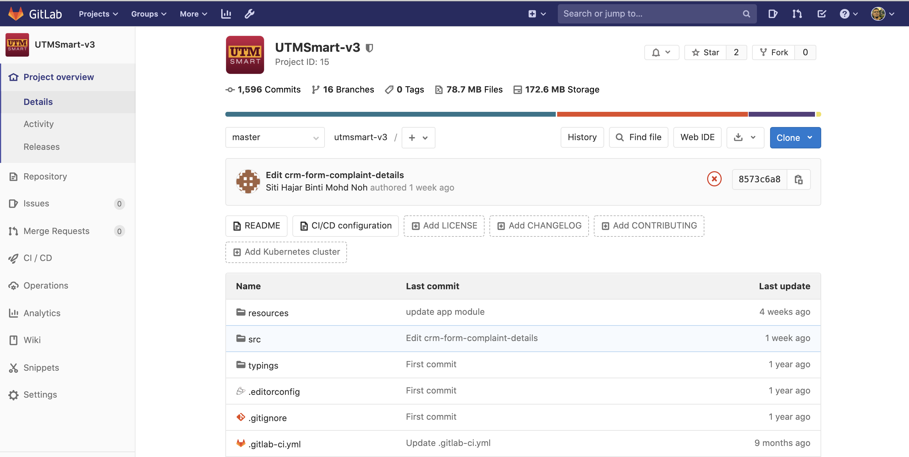
Integration Tool : Git

Slide 10
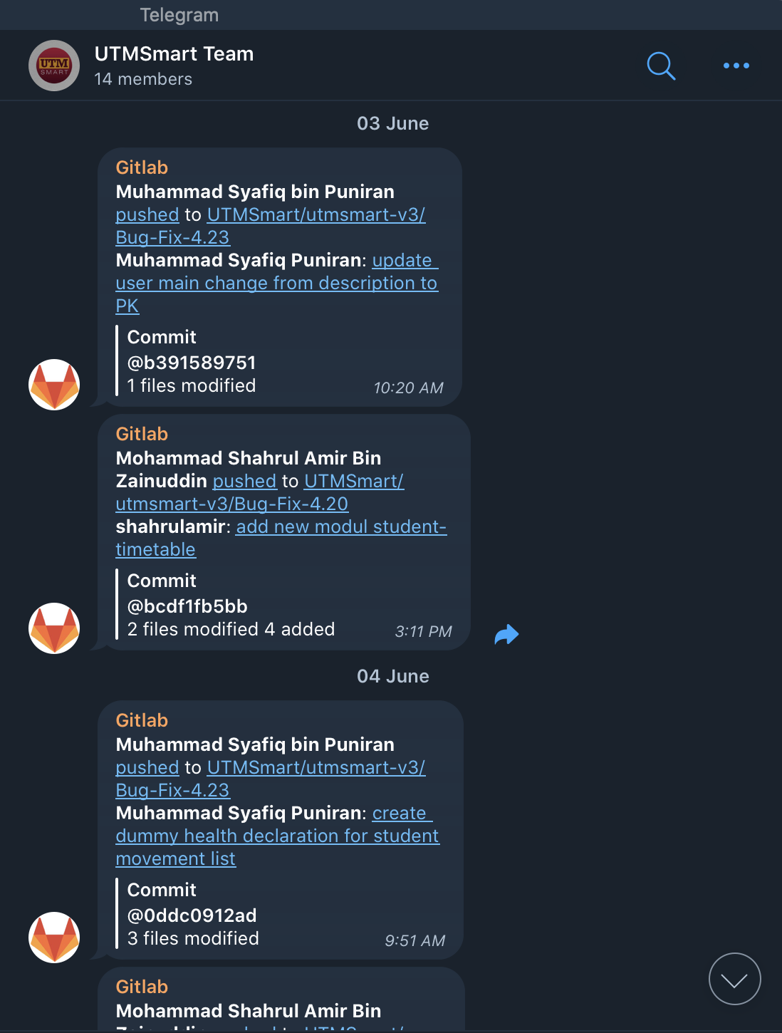
Collaboration Tool
Telegram

Slide 11




Project Timeline
since March 2019
START AGILE IMPLEMENTATION
Ver 3.11
VERSION 1.0
VERSION 3.0
Ver 3.10
VERSION 4.0
Ver 3.01
VERSION 2.0
Ver 3.04
Ver 3.12
Ver 4.01
Ver 4.10
Ver 4.11
2019
SPRINT#1
SPRINT#3
SPRINT#5
SPRINT#7
SPRINT#9
SPRINT#0
SPRINT#2
SPRINT#4
SPRINT#6
SPRINT#8
SPRINT#10
4 Mar 2018
4 Mar
28 Mar
18 Apr
16 May
1 July
9 Aug
1 Sept
25 Sept
17 Oct
3 Nov
17 Dec
18 Developers
4 Developers
53 MODULES
New Modules
Consultation/Support Period : 21 April until 18 Aug 2019

Slide 12
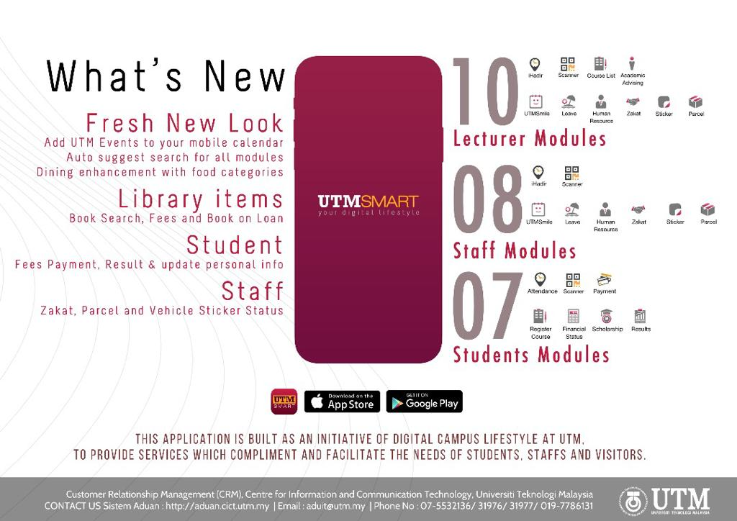
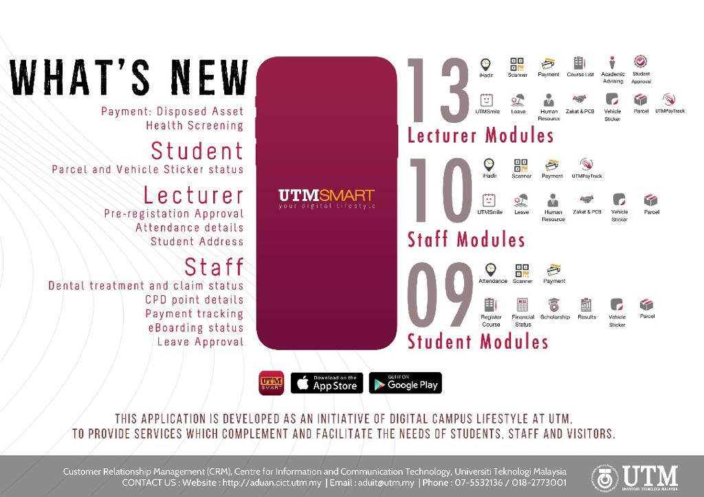

Slide 13
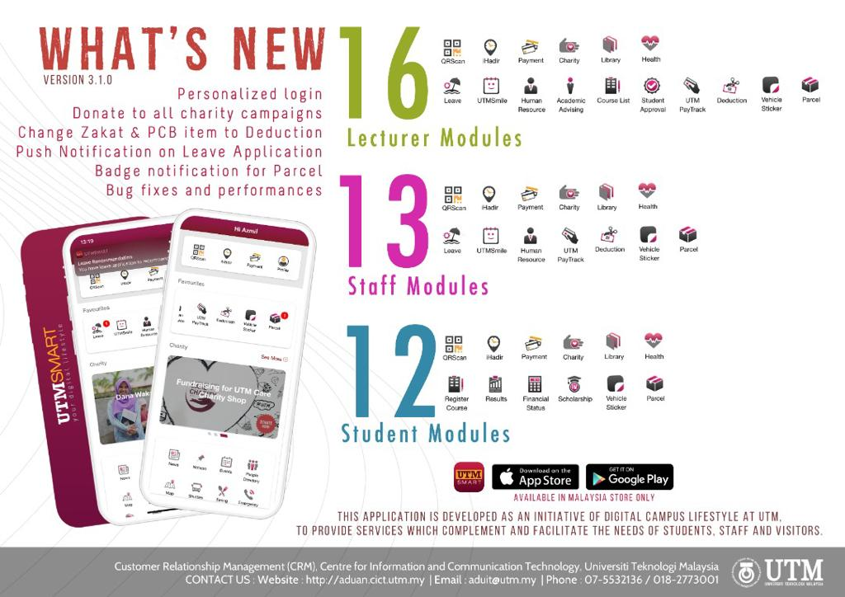
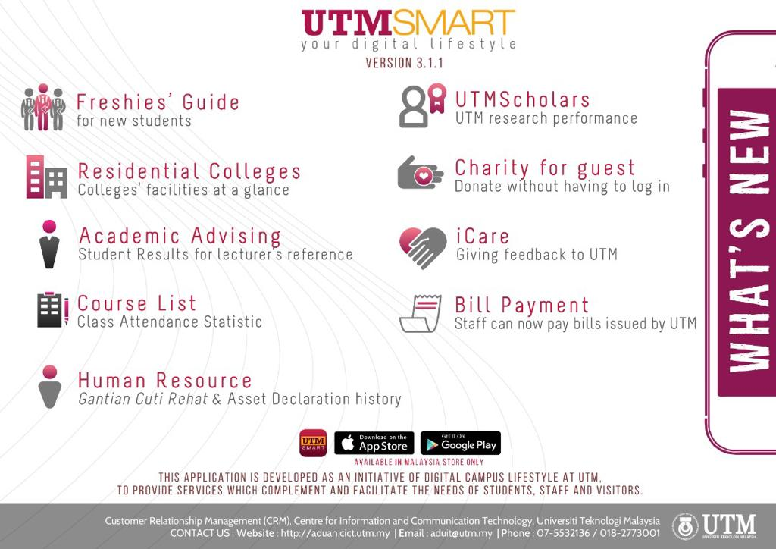

Slide 14
Project Timeline
until November 2020
VERSION 4.12
Ver 4.24
Ver 4.32
Ver 4.17
Ver 4.21
Ver 4.25
Ver 4.18
Ver 4.16
Vers 4.19
Ver 4.20
Ver 4.22
Ver 4.23
Ver 4.26
Ver 4.28
Ver 4.29
Ver 4.30
Ver 4.34
2020
SPRINT#2
SPRINT#4
SPRINT#6
SPRINT#8
SPRINT#10
SPRINT#1
SPRINT#3
SPRINT#5
SPRINT#7
SPRINT#9
SPRINT#11
14 Jan
3 Feb
2 Apr
29 Apr
28 May
10 June
15 Jul
14 Aug
29 Sept
25 Oct
22 Nov
Ver 4.7
15 MODULES
New Modules (not including modules enhancement)
4 Developers

Slide 15
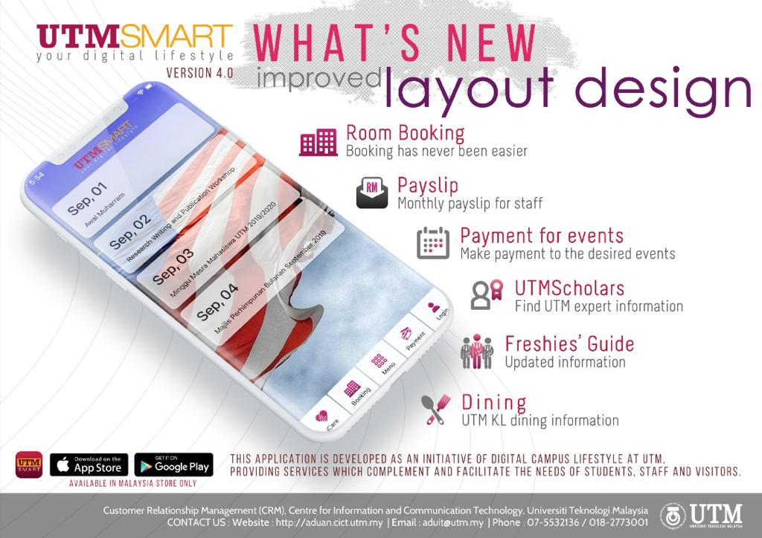
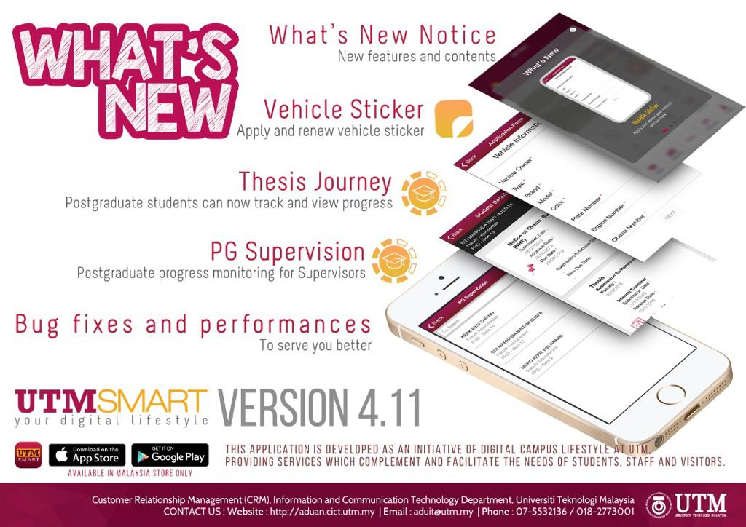

Slide 16
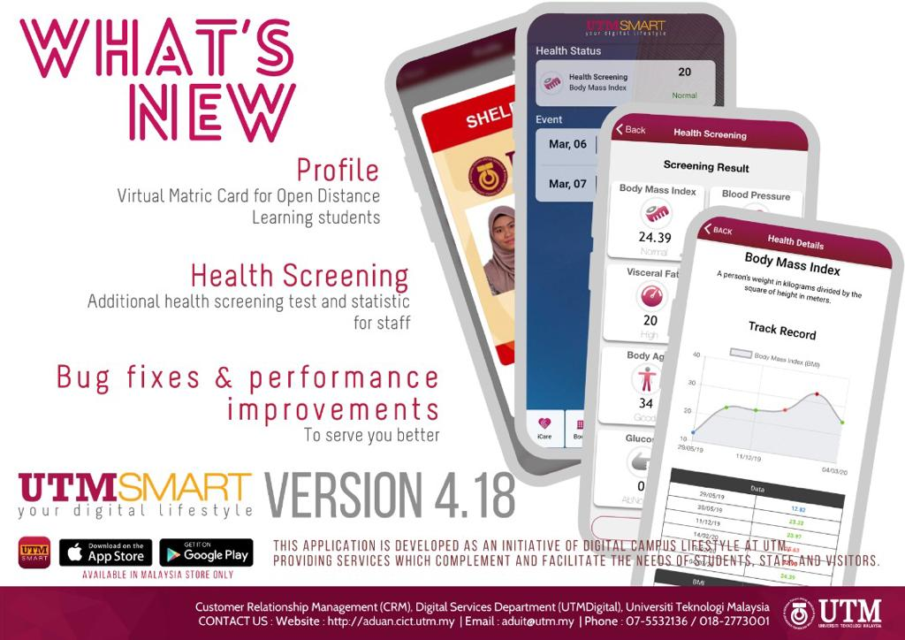
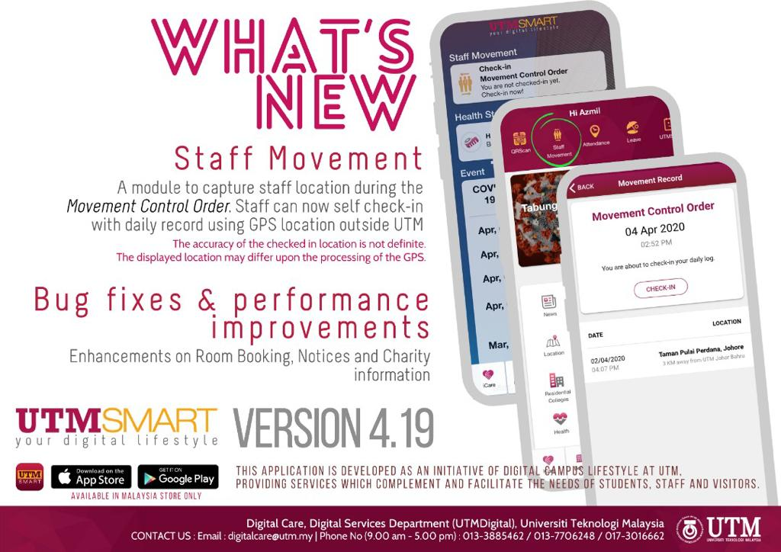

Slide 17
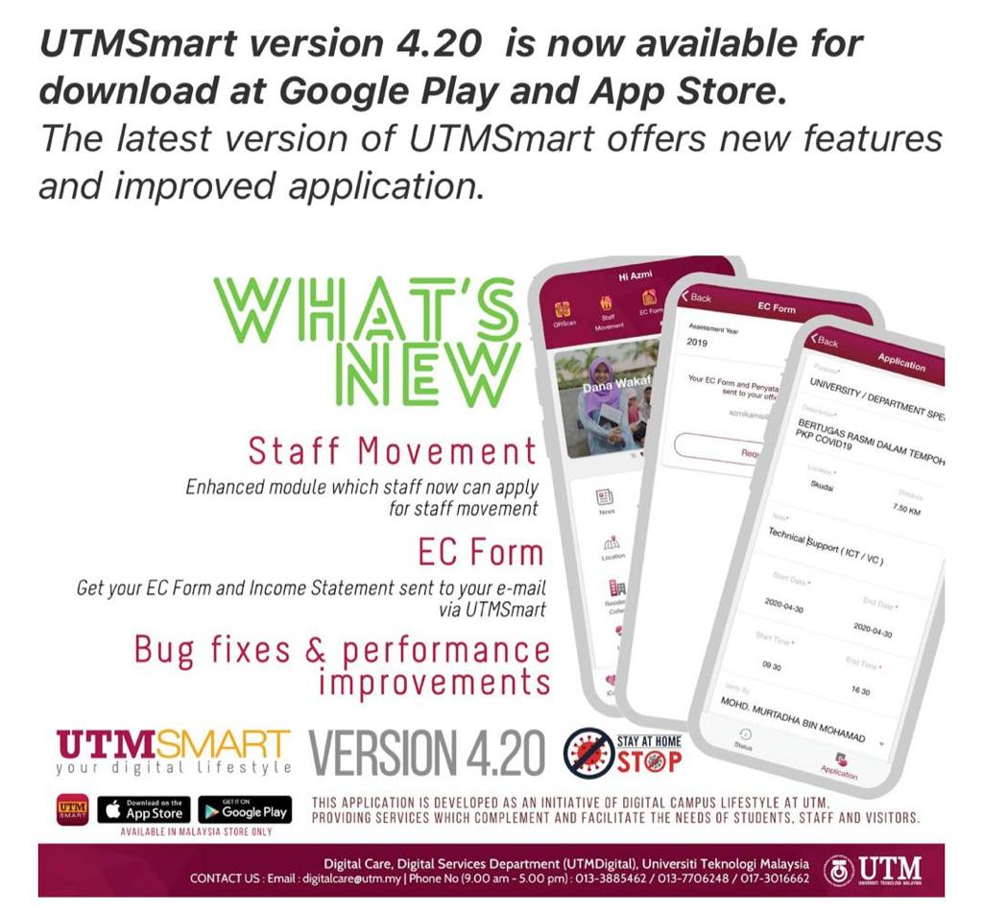
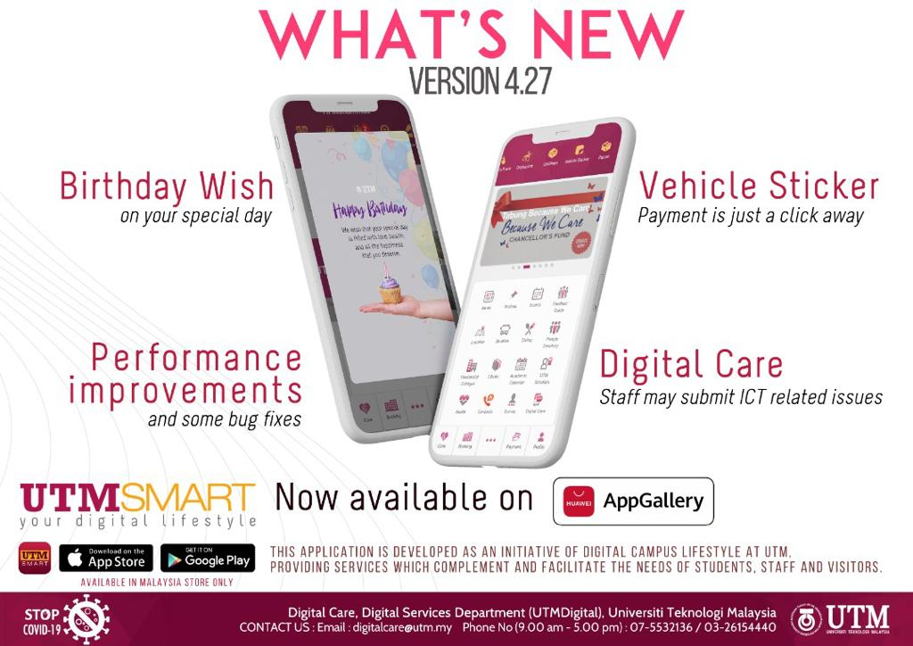

Slide 18
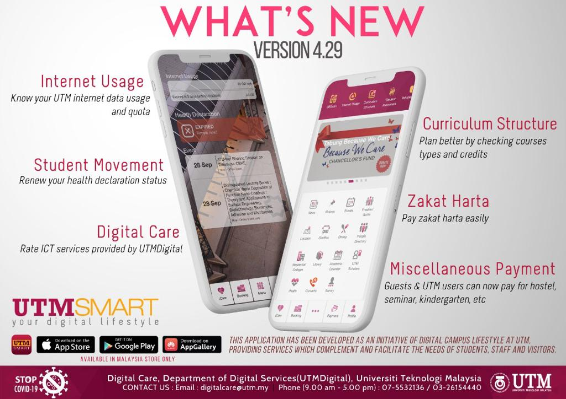

Slide 19
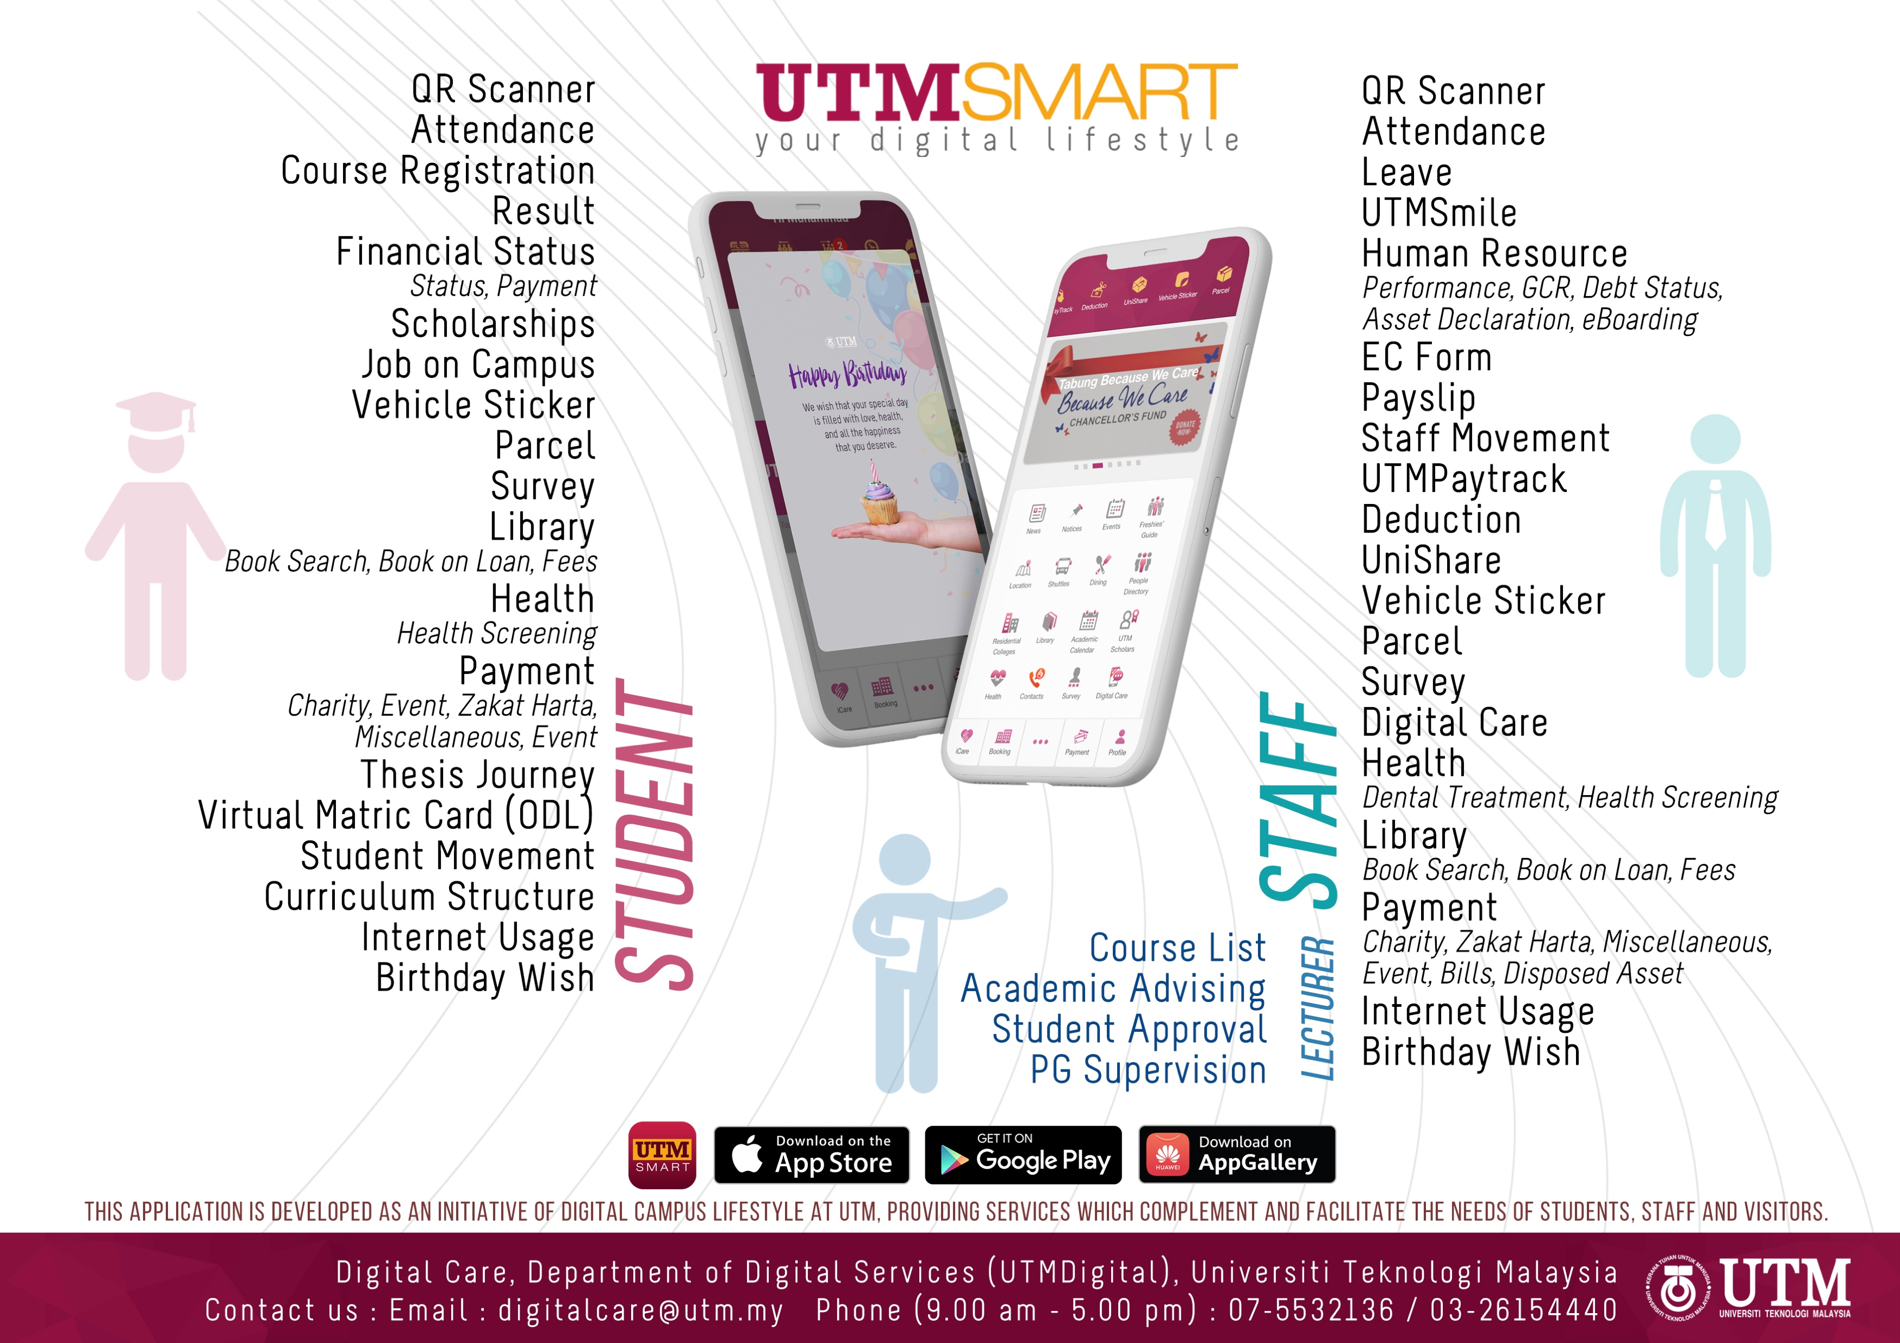
,,
This application is built as an initiative of digital campus lifestyle at UTM, to provide services which complement and facilitate the needs of students, staff and even visitors.

Slide 20
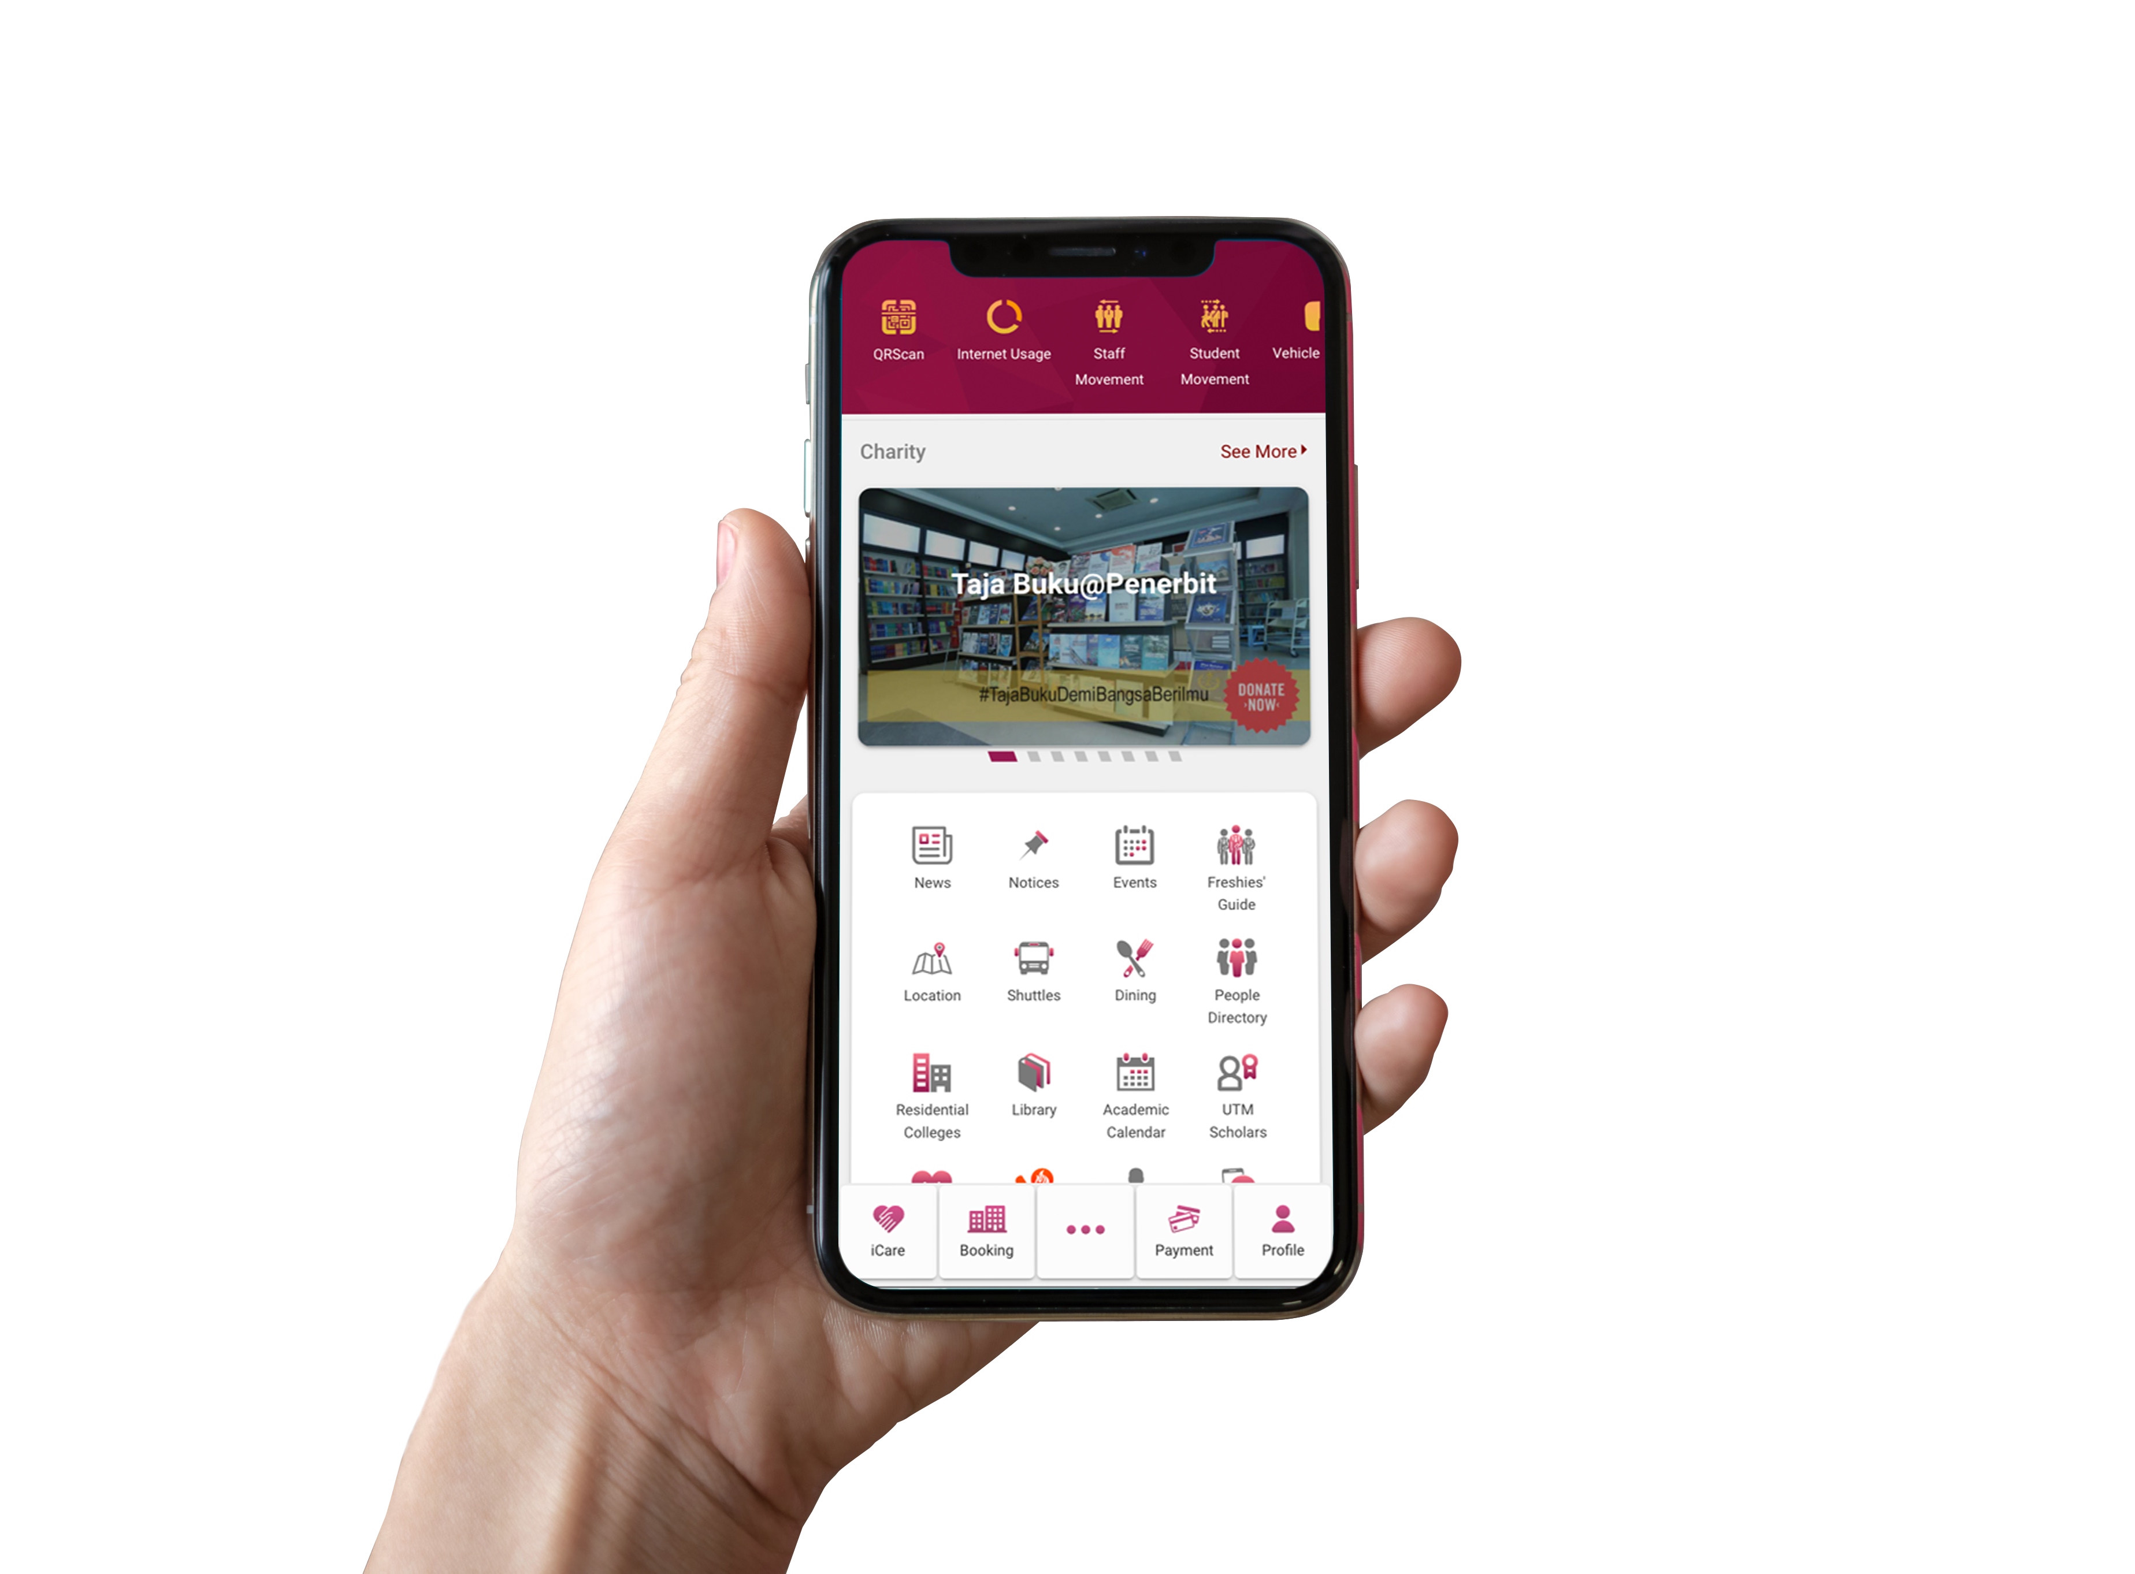
Usage Statistic
Month | Android | iOS | Huawei
October | 23,930 | 1,219 | 4,688
September | 20,966 | 302 | 1,933
August | 21,115 | 386 | 352
July | 20,338 | 479 | -
*Android Data – increment by month
*iOS & Huawei Data by monthly basis

